Slide 1
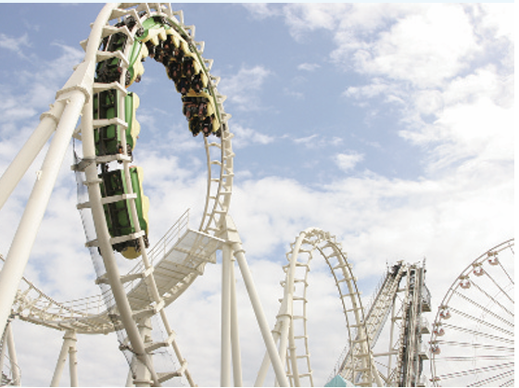
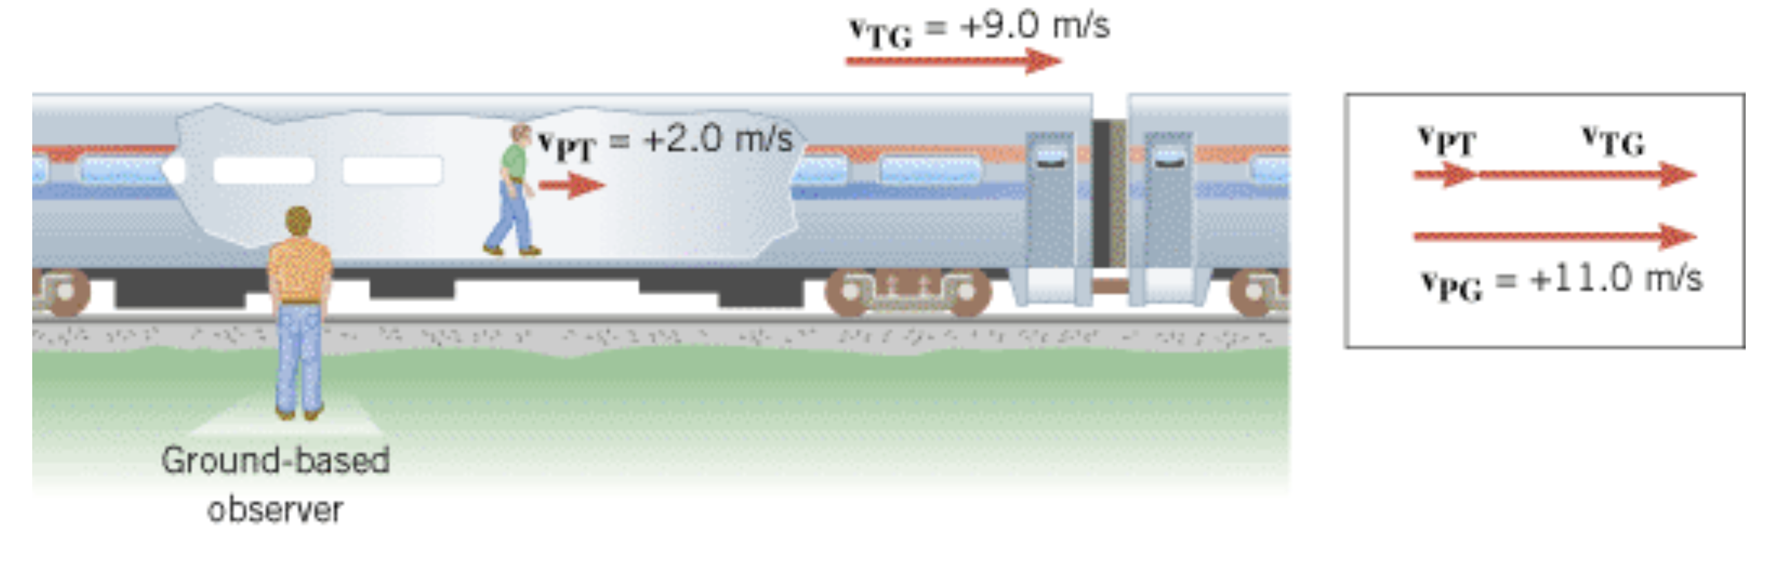
Centripetal Acceleration and relative velocity

Slide 2
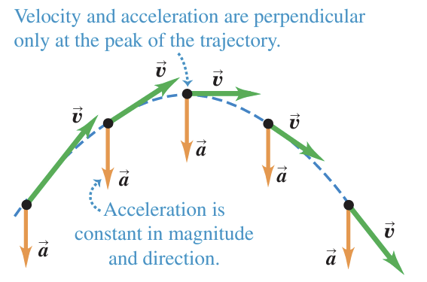
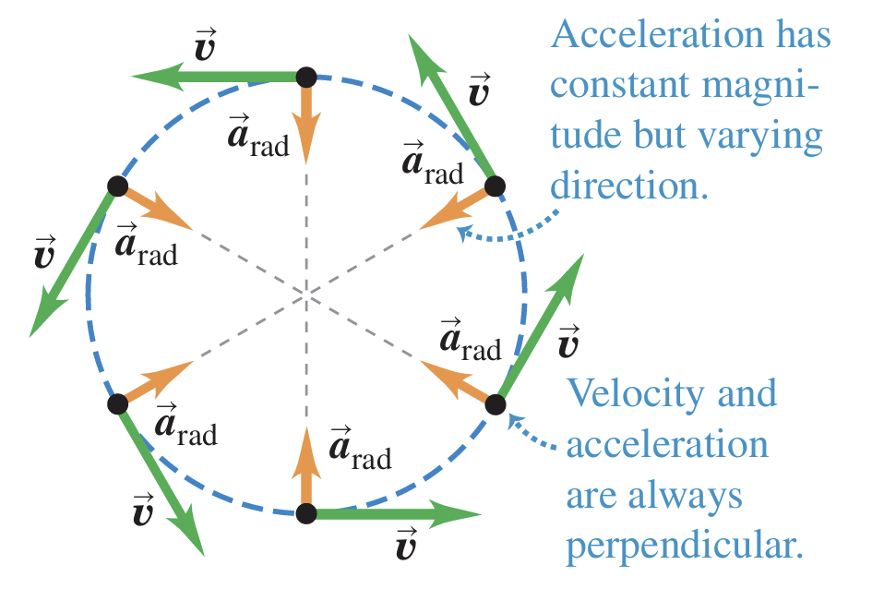
Uniform Circular Motion
Projectile motion
Uniform circular motion occurs when an object moves in a circular path with a constant speed.
An acceleration exists since the direction of the motion is changing .
This change in velocity is related to an acceleration.
The constant-magnitude velocity vector is always tangent to the path of the object.
Uniform circular motion

Slide 3
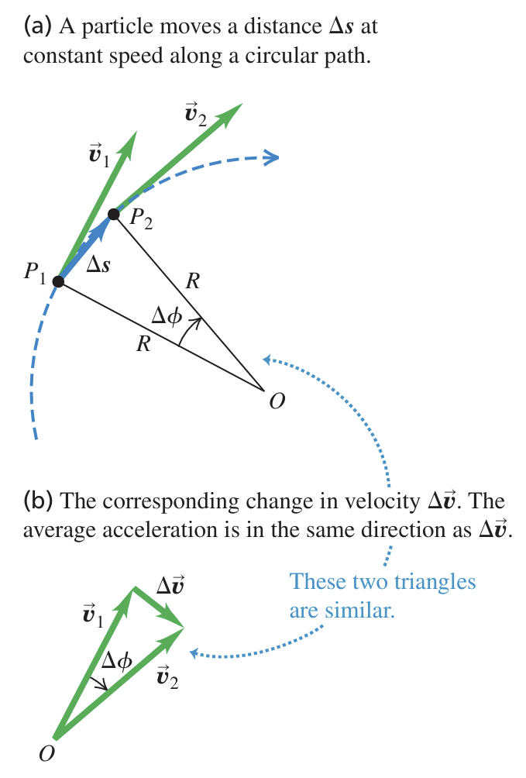
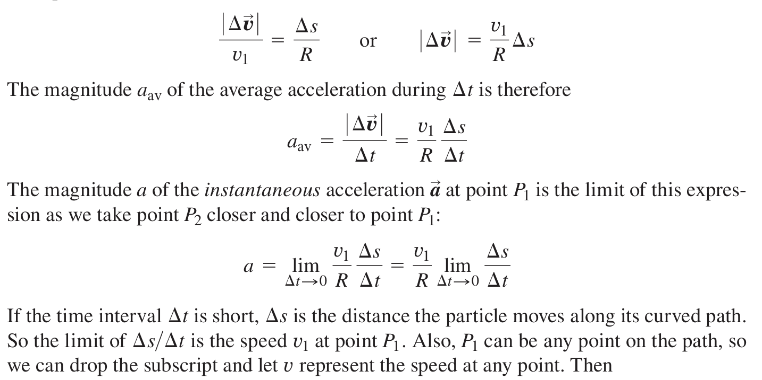
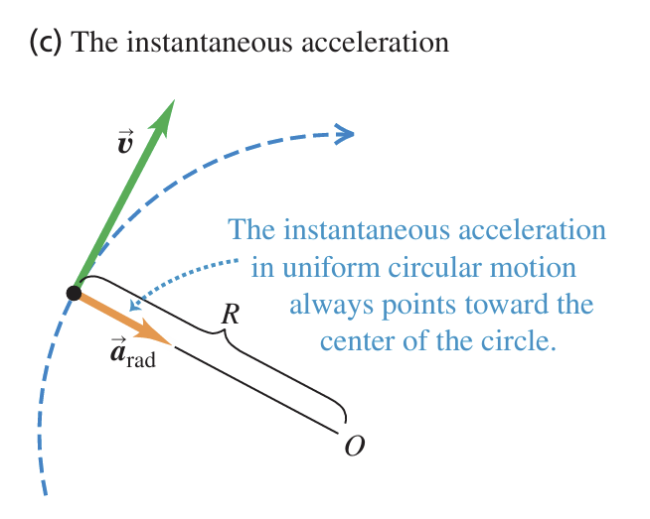


Slide 4
Uniform Circular Motion: Centripetal Acceleration
A particle undergoes uniform circular motion (I.e. moving with a constant speed v in a circular path of radius r) needs an acceleration with magnitude given by
which always pointed towards the center of the circular path.
Such acceleration is called the Centripetal Acceleration.
In vector form, it is expressed as:
where is a unit vector pointing radially outward.

Slide 5
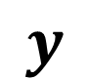
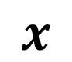
Circular Motion: Polar Coordinates
Denote any position A by:
r: distance to origin
θ: angle of r from the reference direction (x axis, typically)
A
y
Polar (r, θ)
$$y$$
o
x
r
Conversion to Cartesian:
θ
B
x = r cos θ
y = r sin θ
$$x$$
A
Suitable for problems with rotational symmetry
Notes:
Introduce, but will not use as much for now.

Slide 6
Centripetal Acceleration: Derivation Using Calculus
y
x

Slide 7
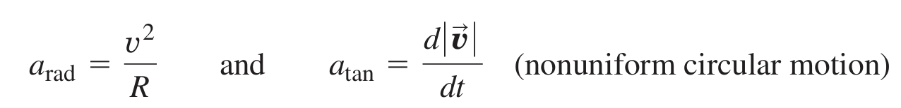
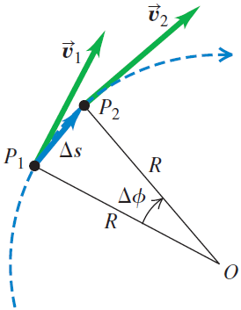
In nonuniform circular motion there is also a component of acceleration that is parallel to the instantaneous velocity. This is the component a_{ll} that we discussed before; here we call this component a_{tan} to emphasize that it is tangent to the circle. This component, called the tangential acceleration a_{tan}, is equal to the rate of change of speed. Thus

Slide 8
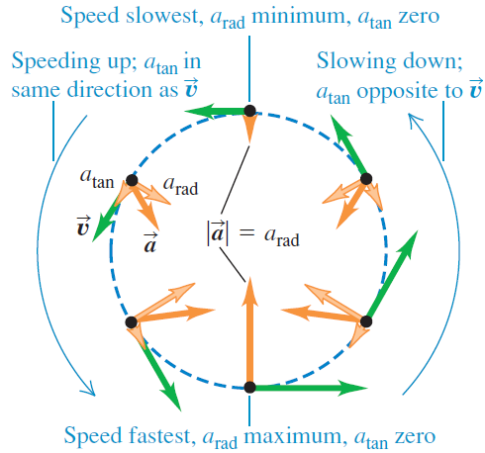
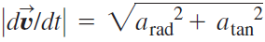
Nonuniform Circular Motion

Slide 9
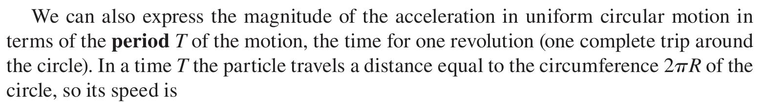
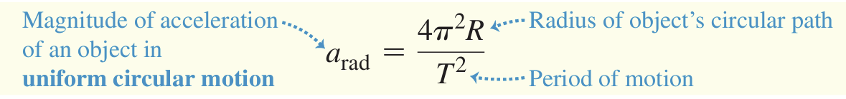

Slide 10
EXAMPLE Centripetal acceleration on a fairground ride
Passengers on a fairground ride move at constant speed in a horizontal circle of radius 5.0 m, making a complete circle in 4.0 s. What is their acceleration?

Slide 11
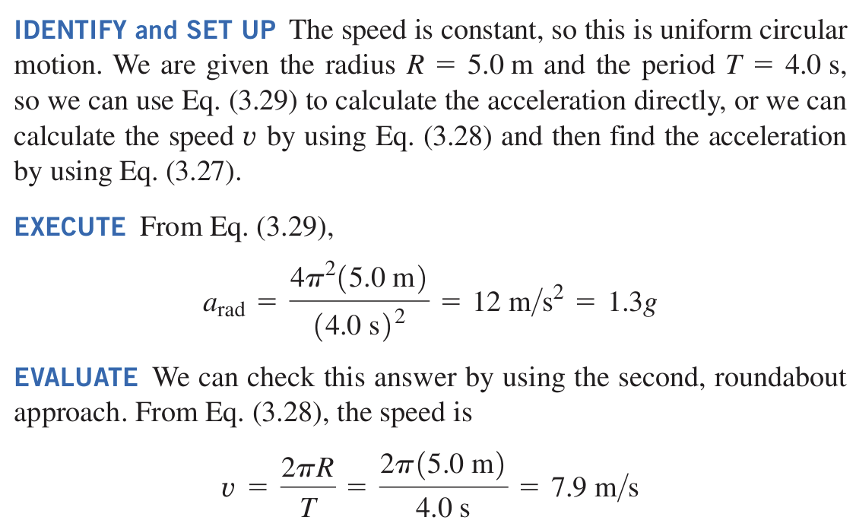
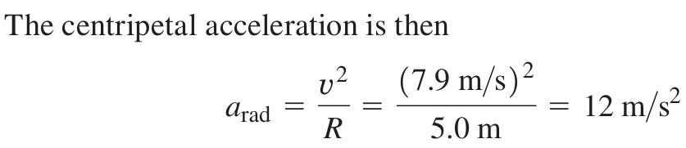

Slide 12
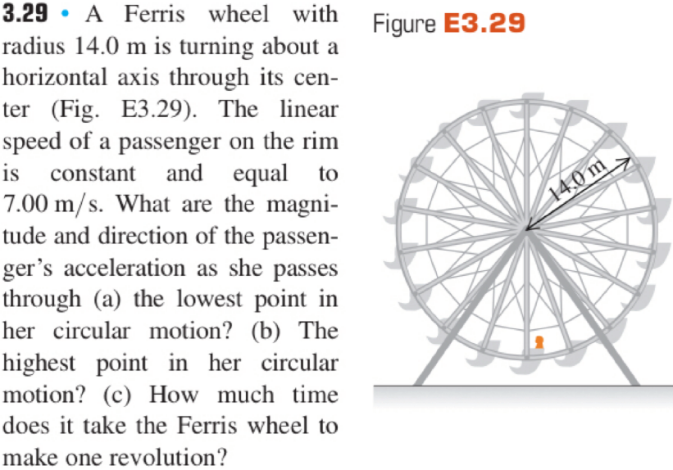
Notes:
Q&A Time

Slide 13
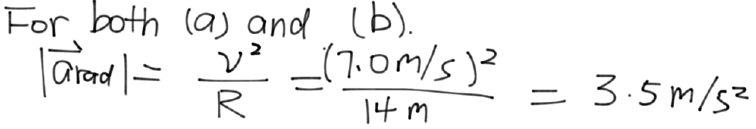
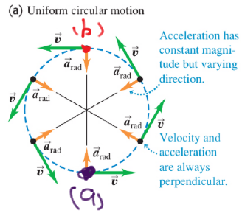
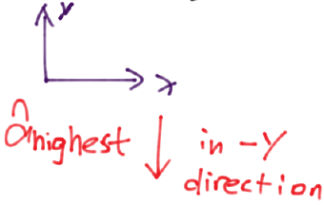
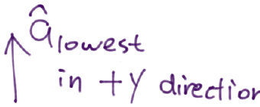
Ferris Wheel
Notes:
Q&A Time

Slide 14
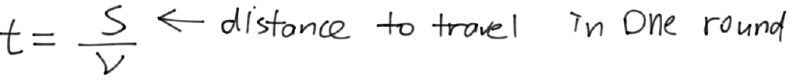
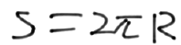
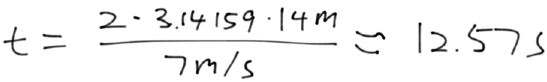
Ferris Wheel
Notes:
Q&A Time

Slide 15
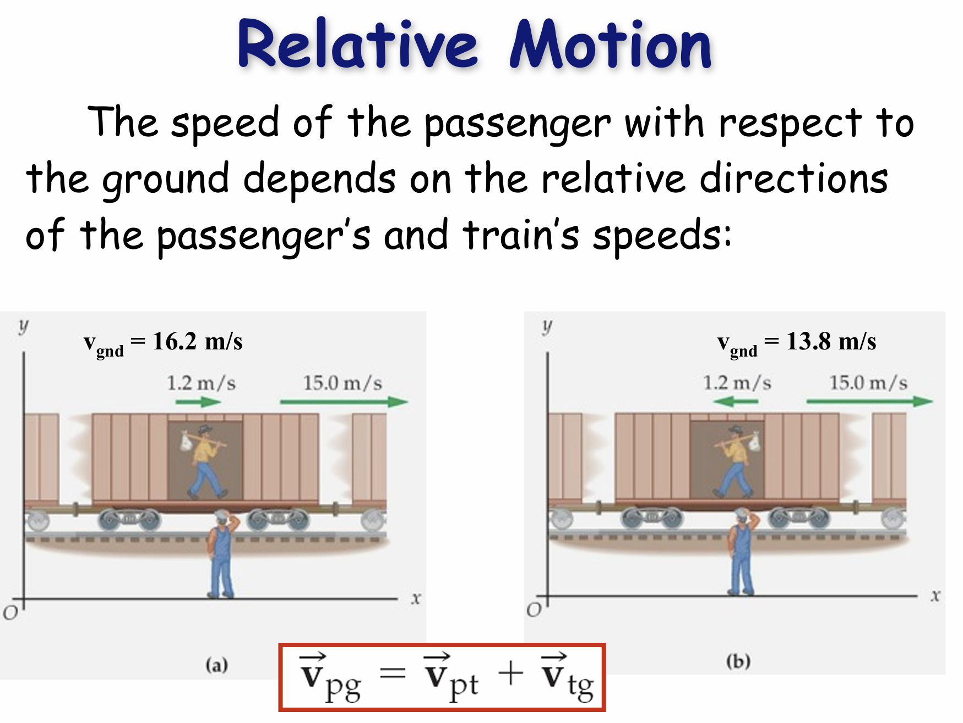

Slide 16
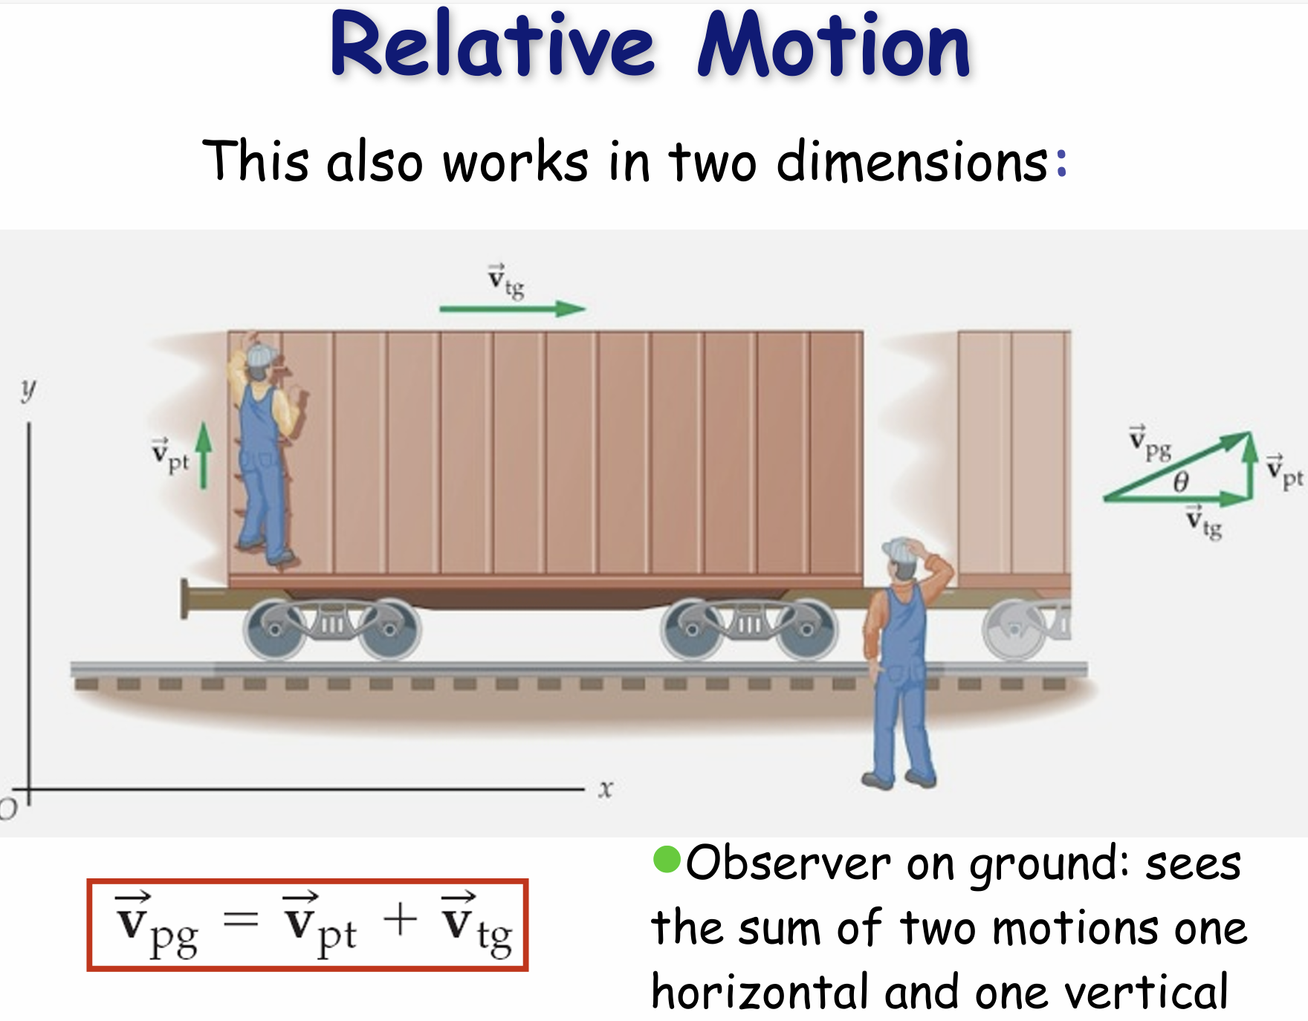

Slide 17
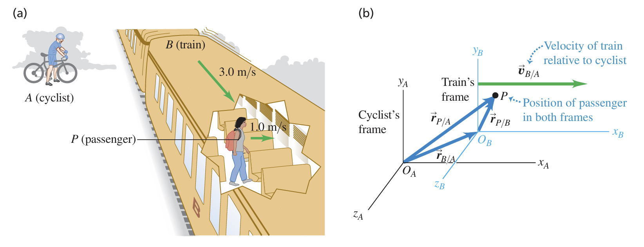
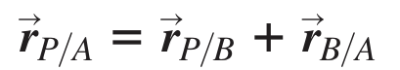
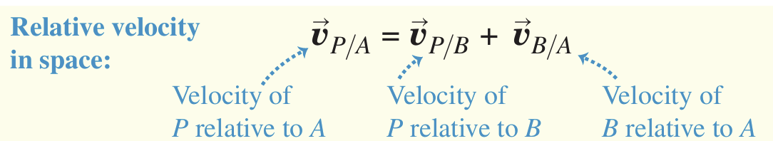

Slide 18
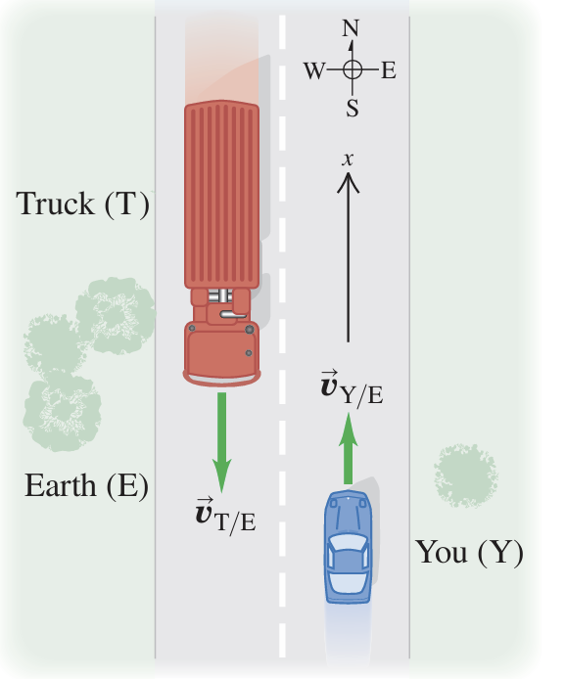
You drive north on a straight two-lane road at a constant 88 km/h. A truck in the other lane approaches you at a constant 104 km/h . Find (a) the truck’s velocity relative to you and (b) your velocity relative to the truck. (c) How do the relative velocities change after you and the truck pass each other? Treat this as a one-dimensional problem.

Slide 19
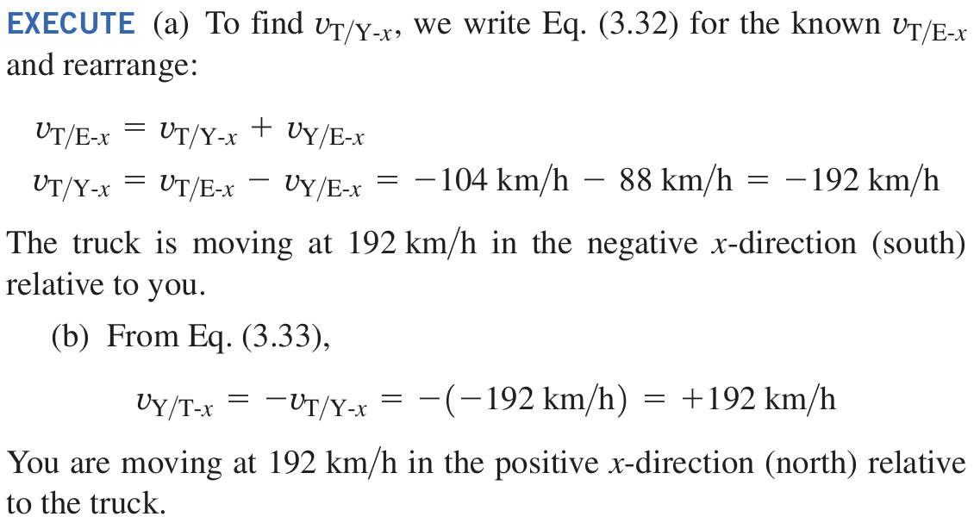
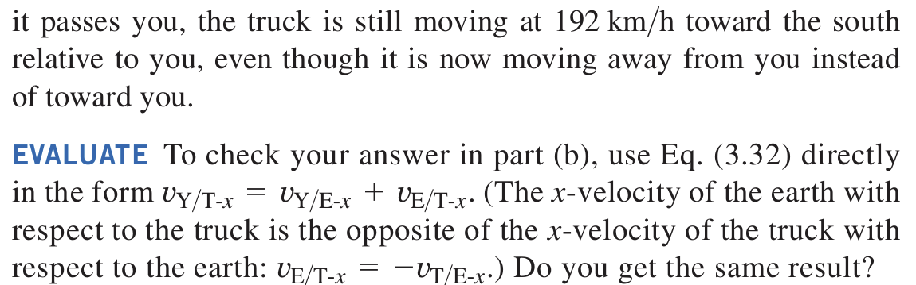

Slide 20
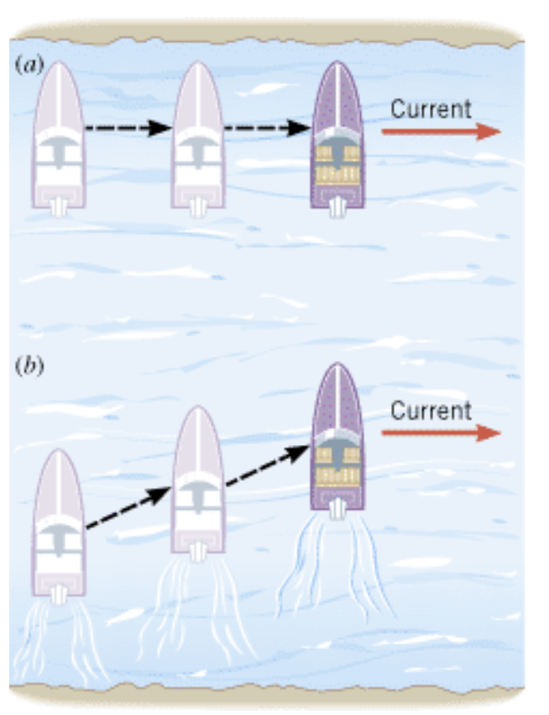
(a) A boat with its engine turned off is carried along by the current. (b) With the engine turned on, the boat moves across the river in a diagonal fashion.

Slide 21
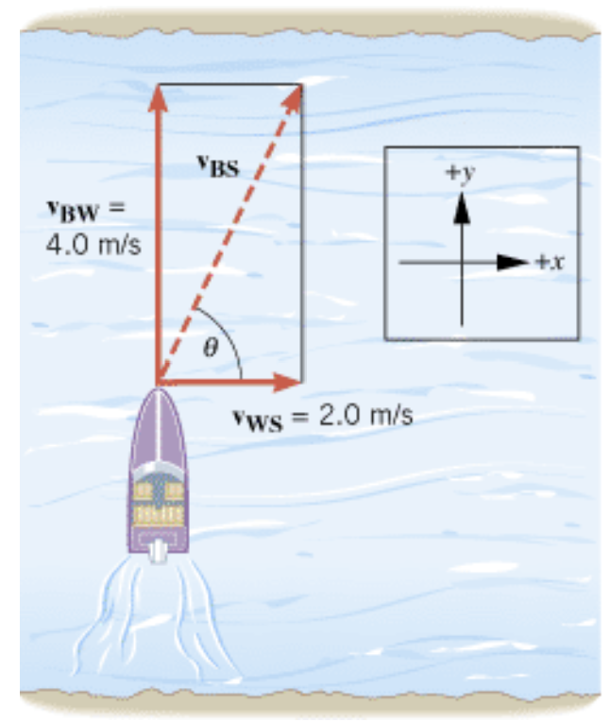
The engine of a boat drives it across a river that is 1800 m wide. The velocity v_{BW} of the boat relative to the water is 4.0 m/s, directed perpendicular to the current, as in Figure. The velocity v_{WS} of the water relative to the shore is 2.0 m/s. (a) What is the velocity v_{BS} of the boat relative to the shore? (b) How long does it take for the boat to cross the river?
Example Crossing a River
The velocity of the boat relative to the shore is v_{BS}. It is the vector sum of the velocity v_{BW} of the boat relative to the water and the velocity v_{WS} of the water relative to the shore:v_{BS}=v_{BW}+v_{WS}.

Slide 22
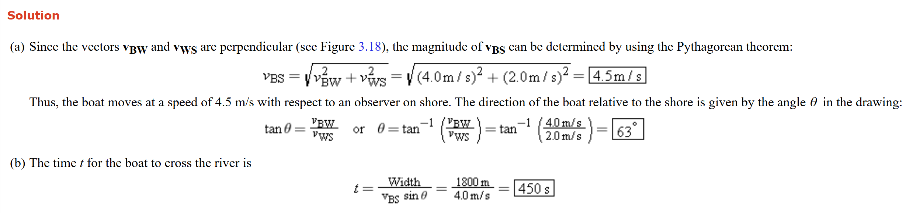

Slide 23
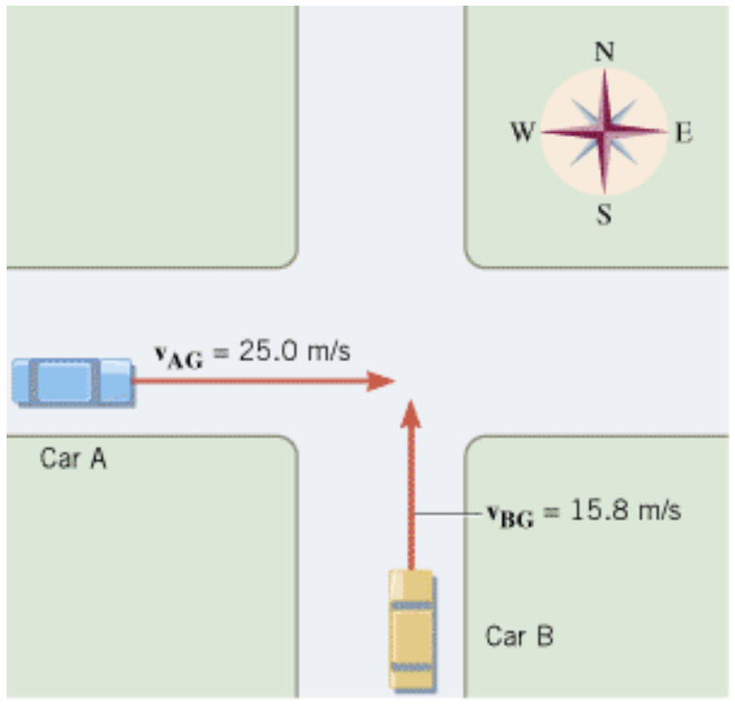
Example Approaching an Intersection
Find the magnitude and direction of v_{AB} (velocity of car A relative to the observers in car B), where

Slide 24
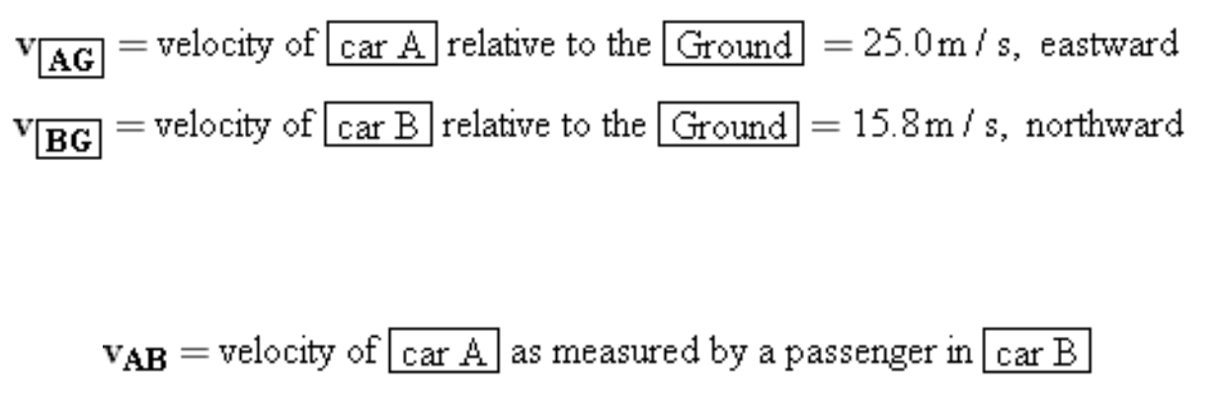
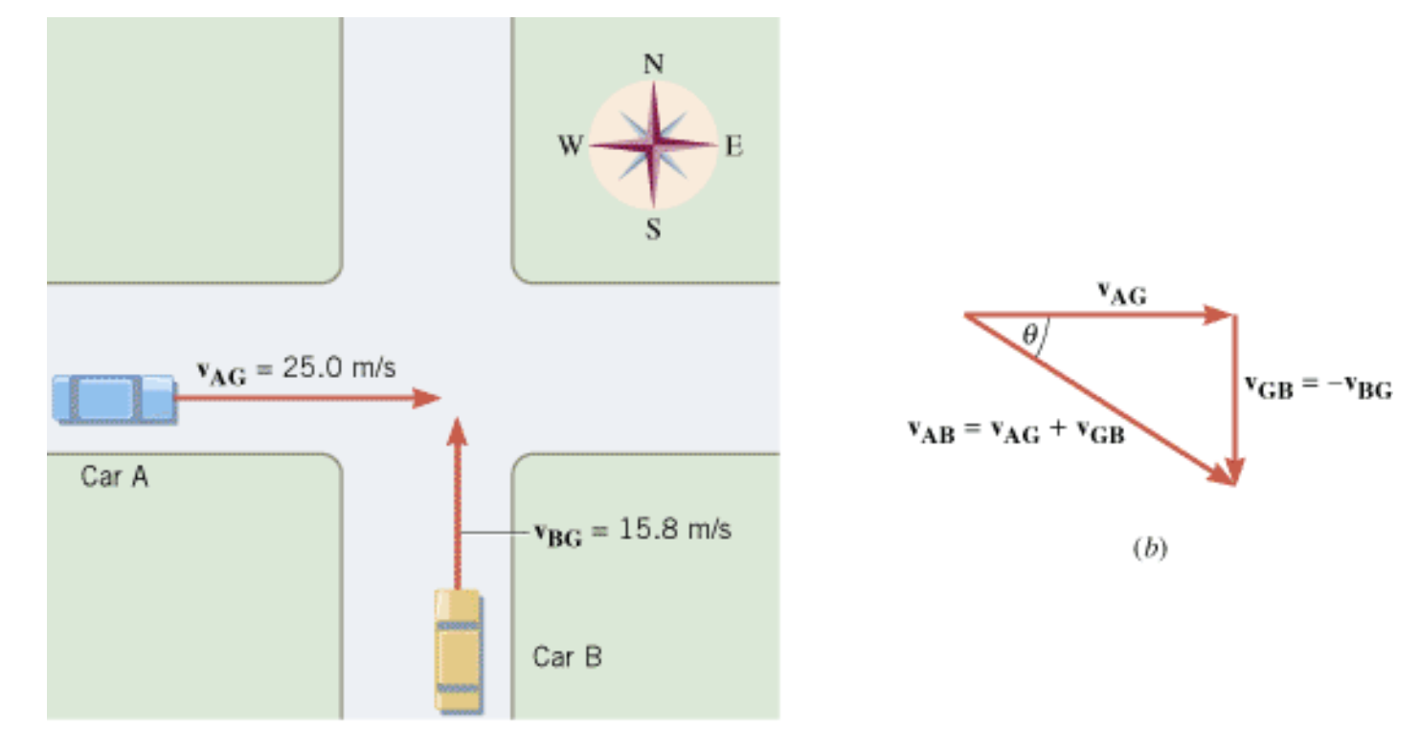
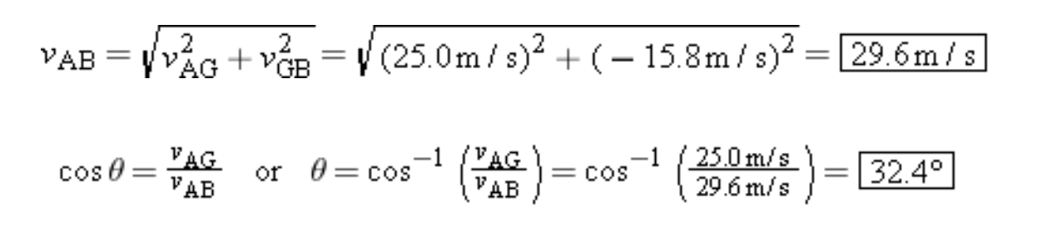

Slide 25
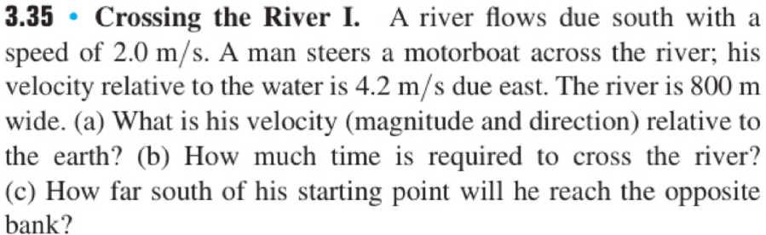
Again, if you don’t know what to do, draw things out!

Slide 26
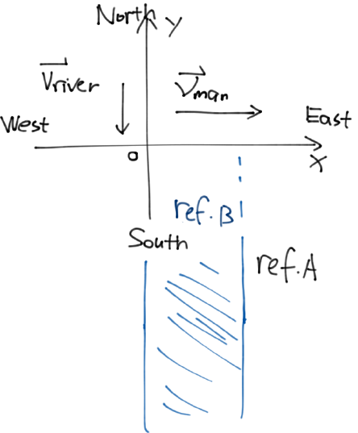
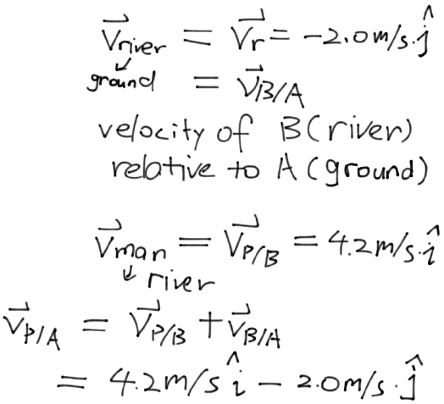
Crossing the River

Slide 27
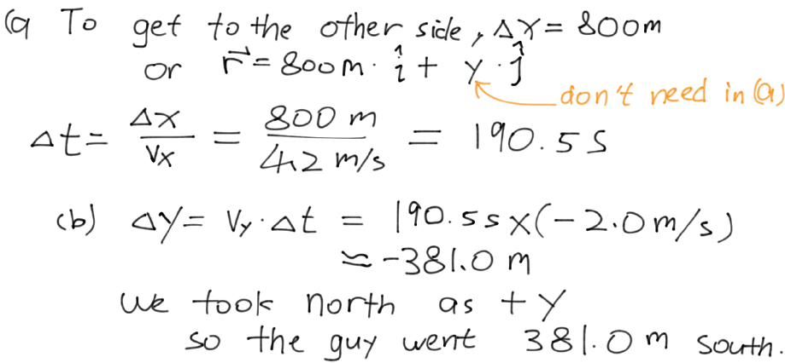
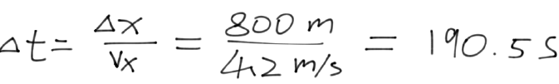
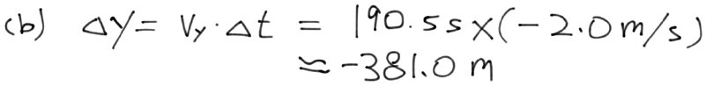
Crossing the River

Slide 28
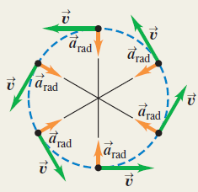
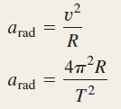
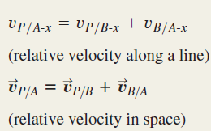
Summary

